Slide 1

Visual Basic.NET Introduction

Slide 2
ROAD MAP
Introduction
Variables, Data Types, Constants
Arrays
Flow-Control Statements
Loop Structures

Slide 3
INTRODUCTION
Visual basics and Visual Basics .NET
We’ve already learnt Visual basics
.NET : a name for a new software platform
.NET framework: fundamental component.
Enormous collection of functions for just about any programming task.
Advantage:
Easy to learn
Powerful

Slide 4
INTRODUCTION
Visual basics and Visual Basics .NET
We’ve already learnt Visual basics
.NET : a name for a new strategy
.NET framework: fundamental component.
Enormous collection of functions for just about any programming task.
Advantages:
Easy to learn
Powerful
Similar to C#

Slide 5
Module Structure
Topic 1 Visual Basic.NET Introduction
Topic 2 Using Procedures
Topic 3 Working with Forms
Topic 4 Windows Controls
Topic 5 More Windows Controls
Topic 6 Building Custom Classes
Topic 7 Building Custom Windows Controls
Topic 8 Automation of Microsoft Office Applications

Slide 6
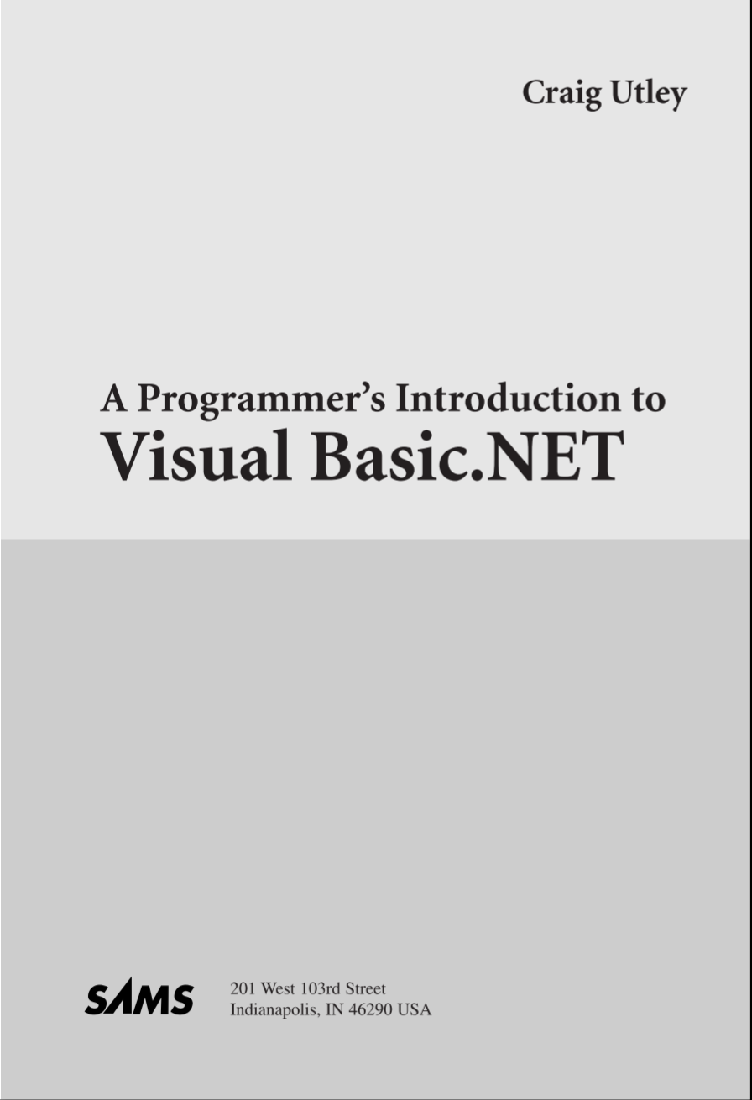
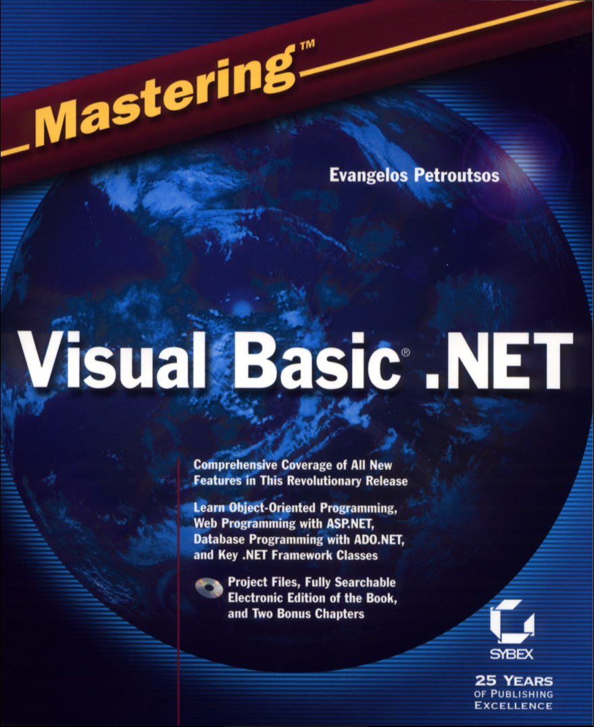
Books
Mastering Visual Basic .NET 2002
A programmer's introduction to VB.NET 2001

Slide 7
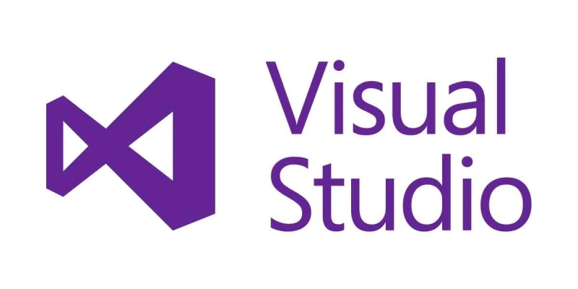
Installation
Environment: Visual Studio
Microsoft official website

Slide 8
Variables, Data Types and Constants
Although not an absolute requirement, VB.NET encourages the declaration of variables, which is a default setting.
Types of Variables
Numeric
String
Boolean
Date
Object

Slide 9
Numeric Variables
Integers (there are several integer data types)
Decimals
Single, or floating-point numbers with limited precision
Double, or floating-point numbers with extreme precision

Slide 10
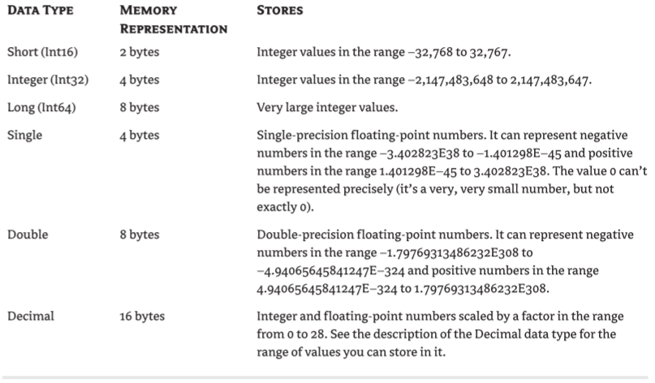
Basic Numeric Data Type

Slide 11
Infinity and Other Oddities
VB.NET can represent two very special values, which may not be numeric values themselves but are produced by numeric calculations:
NaN (not a number) and Infinity.
If your calculations produce NaN or Infinity, you should confirm the data and repeat the calculations, or give up.
For all practical purposes, neither NaN nor Infinity can be used in everyday business calculations.

Slide 12
Let’s generate an Infinity value. Start by declaring a Double variable, The string “Infinity” will appear on a message box:
Dim dblVar As Double = 999
Then divide this value by zero:
Dim infVar as Double
infVar = dblVar / 0
and display the variable’s value:
MsgBox(infVar)

Slide 13
Another calculation that will yield a non-number is when you divide a very large number by a very small number. If the result exceeds the largest value that can be represented with the Double data type, the result is Infinity.
Declare three variables as follows:
Dim largeVar As Double = 1E299
Dim smallVar As Double = 1E-299
Dim result As Double
Then divide the large variable by the small variable and display the result:
result = largeVar / smallVar
MsgBox(result)

Slide 14
Not a Number (NaN)
NaN is not new. Packages like Mathematica and Excel have been using it for years.
The value NaN indicates that the result of an operation can’t be defined: it’s not a regular number, not zero, and not Infinity.
NaN is more of a mathematical concept, rather than a value you can use in your calculations.
The Log() function, for example, calculates the logarithm of positive values. By default, you can’t calculate the logarithm of a negative value. If the argument you pass to the Log() function is a negative value, the function will return the value NaN to indicate that the calculations produced an invalid result.

Slide 15
If you execute these statements, the result will be a NaN. Any calculations that involve the result variable (a NaN value) will yield NaN as a result. The statements will all yield NaN:
result = result + result
result = 10 / result
result = result + 1E299
MsgBox(result)

Slide 16
Testing for Infinity and NaN
To find out whether the result of an operation is a NaN or Infinity, use the IsNaN and IsInfinity methods of the Single and Double data type.
The Integer data type doesn’t support these methods, even though it’s possible to generate Infinity and NaN results with Integers. If the IsInfinity method returns True, you can further examine the sign of the Infinity value with the IsNegativeInfinity and IsPositiveInfinity methods.
In most situations, you’ll display a warning and terminate the calculations.

Slide 17
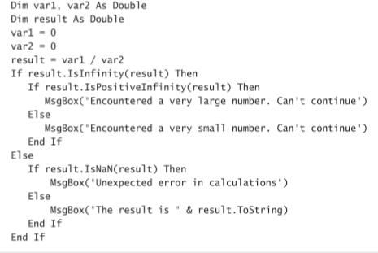
Handling NaN and Infinity Values

Slide 18
User-Defined Data Types
In the previous sections, we assumed that applications create variables to store individual values. As a matter of fact, most programs store sets of data of different types.
For example, a program for balancing your checkbook must store several pieces of information for each check: the check’s number, amount, date, and so on. All these pieces of information are necessary to process the checks, and ideally, they should be stored together.

Slide 19
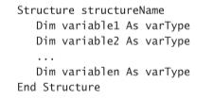
Define a record in VB.NET

Slide 20
The Nothing Value
The Nothing value is used with Object variables and indicates a variable that has not been initialized. If you want to disassociate an Object variable from the object it represents, set it to Nothing.
The following statements create an Object variable that references a Brush, use it, and then release it:
Dim brush As System.Drawing.Brush
brush = New System.Drawing.Brush(bmap)
{ use brush object to draw with }
brush = Nothing

Slide 21
Examining Variable Types
Besides setting the types of variables and the functions for converting between types, Visual Basic provides two methods that let you examine the type of a variable.
They are the GetType() and GetTypeCode() methods.
The GetType() method returns a string with the variable’s type (“Int32”, “Decimal”, and so on).
The GetTypeCode() method returns a value that identifies the variable’s type.

Slide 22
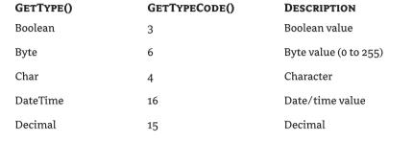
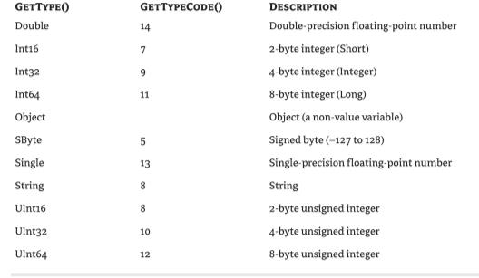

Slide 23
A Number or a String
Another set of Visual Basic functions returns variables’ data types, but not the exact type. They return a broader type, such as “numeric” for all numeric data types.
This is the type you usually need in your code. The following functions are used to validate user input, as well as data stored in files, before you process them.
IsNumeric()
Returns True if its argument is a number
IsArray()
IsDate()

Slide 24
Constants
Some variables don’t change value during the execution of a program. These are constants that appear many times in your code.
For instance, if your program does math calculations, the value of pi (3.14159…) may appear many times. Instead of typing the value 3.14159 over and over again, you can define a constant, name it pi, and use the name of the constant in your code. The statement
circumference = 2 * pi * radius
is much easier to understand than the equivalent
circumference = 2 * 3.14159 * radius.

Slide 25
You could declare pi as a variable, but constants are preferred for two reasons:
Constants don’t change value.
This is a safety feature. Once a constant has been declared, you can’t change its value in subsequent statements, so you can be sure that the value specified in the constant’s declaration will take effect in the entire program.
Constants are processed faster than variables.
When the program is running, the values of constants don’t have to be looked up. The compiler substitutes constant names with their values, and the program executes faster.
a

Slide 26
The manner in which you declare constants is similar to the manner in which you declare variables, except that in addition to supplying the constant’s name, you must also supply a value, as follows:
Const constantname As type = value
Constants also have a scope and can be Public or Private. The constant pi, for instance, is usually declared in a module as Public so that every procedure can access it:
Public Const pi As Double = 3.14159265358979

Slide 27
The best way to define the value of the pi variable is to use the pi member of the Math class:
pi = Math.pi
However, you can’t use this assignment in the constant declaration. You must supply the actual value.
Constants can be strings, too, like these:
Const ExpDate = #31/12/1997#
Const ValidKey = “A567dfe”

Slide 28
Constant declarations may include other constants.
In math calculations, the value 2 × pi is almost as common as the value pi. You can declare these two values as constants:
Public Const pi As Double = 3.14159265358979
Public Const pi2 As Double = 2 * pi

Slide 29
Arrays
Unlike simple variables, arrays must be declared with the Dim (or Public, or Private) statement followed by the name of the array and the index of the last element in the array in parentheses—for example,
Dim Salaries(15) As Integer
Salaries is the name of an array that holds 16 values (the salaries of the 16 employees), with indices ranging from 0 to 15.
Salaries(0) is the first person’s salary, Salaries(1) the second person’s salary, and so on.

Slide 30
Declaring Arrays
All you have to do is remember who corresponds to each salary, but even this data can be handled by another array. To do this, you’d declare another array of 16 elements as follows:
Dim Names(15) As String
and then assign values to the elements of both arrays:
Names(0) = “Joe Doe”
Salaries(0) = 34000
Names(1) = “Beth York”
Salaries(1) = 62000
...
Names(15) = “Peter Smack”
Salaries(15) = 10300

Slide 31
Initializing Arrays
Just as you can initialize variables in the same line where you declare them, you can initialize arrays, too, with the following constructor:
Dim arrayname() As type = {entry0, entry1, … entryN}
Example that initializes an array of strings:
Dim names() As String = {“Joe Doe”, “Peter Smack”}
This statement is equivalent to the following statements, which declare an array with two elements and then set their values:
Dim names(1) As String
names(0) = “Joe Doe”
names(1) = “Peter Smack”

Slide 32
Array Limits
The first element of an array has index 0. The number that appears in parentheses in the Dim statement is one less than the array’s total capacity and is the array’s upper limit (or upper bound).
The index of the last element of an array (its upper bound) is given by the function UBound(), which accepts as argument the array’s name. For the array
Dim myArray(19) As Integer
its upper bound is 19, and its capacity is 20 elements.

Slide 33
Flow-Control Statements
Test Structures An application needs a built-in capability to test conditions and take a different course of action depending on the outcome of the test. Visual Basic provides three such decision structures:
If…Then
If…Then…Else
Select Case

Slide 34
If…Then
The If…Then statement tests the condition specified; if it’s True, the program executes the statement(s) that follow. The If structure can have a single-line or a multiple-line syntax.
To execute one statement conditionally, use the single-line syntax as follows:
If <condition> Then <statement>
Visual Basic evaluates the condition, and if it’s True, executes the statement that follows. If the condition is False, the application continues with the statement following the If statement. You can also execute multiple statements by separating them with colons:
If <condition> Then <statement>: <statement>: <statement>

Slide 35
Example
Here’s an example of a single-line If statement
If Month(expDate) > 12 Then expYear = expYear + 1: expMonth = 1
You can break this statement into multiple lines by using End If, as shown here:
If expDate.Month > 12 Then
expYear = expYear + 1
expMonth = 1
End If

Slide 36
If…Then…Else
A variation of the If…Then statement is the If…Then…Else statement, which executes one block of statements if the condition is True and another block of statements if the condition is False.
Visual Basic evaluates the condition; if it’s True, VB executes the first block of statements and then jumps to the statement following the End If statement. If the condition is False, Visual Basic ignores the first block of statements and executes the block following the Else keyword.
The syntax of the If…Then…Else statement is as follows:
If <condition> Then
<statementblock1>
Else
<statementblock2>
End If

Slide 37
Another variation of the If…Then…Else statement uses several conditions, with the ElseIf keyword:
If <condition1> Then
<statementblock1>
ElseIf <condition2> Then
<statementblock2>
ElseIf <condition3> Then
<statementblock3>
Else
<statementblock4>
End If

Slide 38
Select Case
An alternative to the efficient, but difficult-to-read, code of the multiple-ElseIf structure is the Select Case structure, which compares one expression to different values.
The advantage of the Select Case statement over multiple If…Then…Else/ElseIf statements is that it makes the code easier to read and maintain.

Slide 39
The Select Case structure tests a single expression, which is evaluated once at the top of the structure. The result of the test is then compared with several values, and if it matches one of them, the corresponding block of statements is executed.
Here’s the syntax of the Select Case statement:
Select Case <expression>
Case value1
statementblock1
Case value2
statementblock2 .
.
.
Case Else
statementblockN
End Select

Slide 40
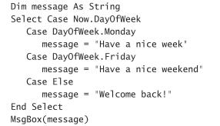
Exercises: Using the Select Case Statement

Slide 41
Loop Structures
Loop structures allow you to execute one or more lines of code repetitively. Many tasks consist of trivial operations that must be repeated over and over again, and looping structures are an important part of any programming language. Visual Basic supports the following loop structures:
For…Next
Do…Loop
While…End While

Slide 42
For…Next
The For…Next loop is one of the oldest loop structures in programming languages. Unlike the other two loops, the For…Next loop requires that you know how many times the statements in the loop will be executed. The For…Next loop uses a variable (it’s called the loop’s counter) that increases or decreases in value during each repetition of the loop. The For…Next loop has the following syntax:
For counter = start To end [Step increment]
statements
Next [counter]
The keywords in the square brackets are optional.
The arguments counter, start, end, and increment are all numeric.
The loop is executed as many times as required for the counter to reach (or exceed) the end value.

Slide 43
In executing a For…Next loop, Visual Basic completes the following steps:
1. Sets counter equal to start
2. Tests to see if counter is greater than end. If so, it exits the loop. If increment is negative, Visual Basic tests to see if counter is less than end. If it is, it exits the loop.
3. Executes the statements in the block
4. Increments counter by the amount specified with the increment argument. If the increment argument isn’t specified, counter is incremented by 1.
5. Repeats the statements

Slide 44

Exercise: Iterating an Array with a For…Next Loop
This For…Next scans all the elements of the numeric array data and calculates their average.

Slide 45
The single most important thing to keep in mind when working with For…Next loops is that the loop’s counter is set at the beginning of the loop. Changing the value of the end variable in the loop’s body won’t have any effect.
For example, the following loop will be executed 10 times, not 100 times:
endValue = 10
For i = 0 To endValue
endValue = 100
{ more statements }
Next i

Slide 46
You can, however, adjust the value of the counter from within the loop. The following is an example of an endless (or infinite) loop:
For i = 0 To 10
Console.WriteLine(i)
i = i - 1
Next I
*Manipulating the counter of a For…Next loop is strongly discouraged. This practice will most likely lead to bugs such as infinite loops, overflows, and so on. If the number of repetitions of a loop isn’t known in advance, use a Do…Loop or a While…End While structure

Slide 47
Do…Loop
The Do…Loop executes a block of statements for as long as a condition is True. Visual Basic evaluates an expression, and if it’s True, the statements are executed.
When the end of block is reached, the expression is evaluated again and, if it’s True, the statements are repeated. If the expression is False, the program continues and the statement following the loop is executed.

Slide 48
Two Variations
There are two variations of the Do…Loop statement; both use the same basic model. A loop can be executed either while the condition is True or until the condition becomes True. These two variations use the keywords While and Until to specify how long the statements are executed.
To execute a block of statements while a condition is True, use the following syntax:
Do While condition
statement-block
Loop
To execute a block of statements until the condition becomes True, use the following syntax:
Do Until condition
statement-block
Loop

Slide 49
While…End While
The While…End While loop executes a block of statements as long as a condition is True. The While loop has the following syntax:
While condition
statement-block
End While
If condition is True, all statements are executed and, when the End While statement is reached, control is returned to the While statement, which evaluates condition again.
If condition is still True, the process is repeated. If condition is False, the program resumes with the statement following End While.

Slide 50
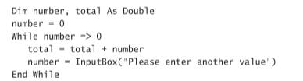
Exercise: Reading an Unknown Number of Values
This loop prompts the user for numeric data. The user can type a negative value to indicate that all values are entered.

Slide 51
Exercise
Recognize the following types of variables:
True/False
10
“There are approximately 29,000 words in this chapter”
#8/27/2001 6:29:11 PM#

Slide 52
Exercise
For the Array:
Dim testArray(9) As Integer
What is its upper bound? And what is its capacity?

